Slide 1
The Secret Lecture

Slide 2
Separating Content From Style
Separating content from style is basic tenet of HTML5
Tags are meant to convey information
But…..

Slide 3

Using the “style” attribute
Every tag can utilize a style attribute.
Similar to href, src, alt, etc.
Style can specify color, background-color, margins, etc.

Slide 4
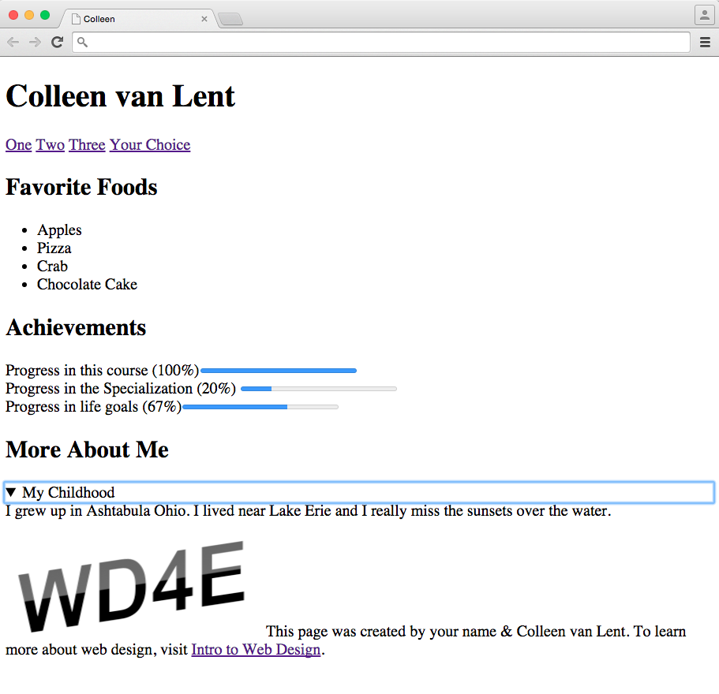

Slide 5
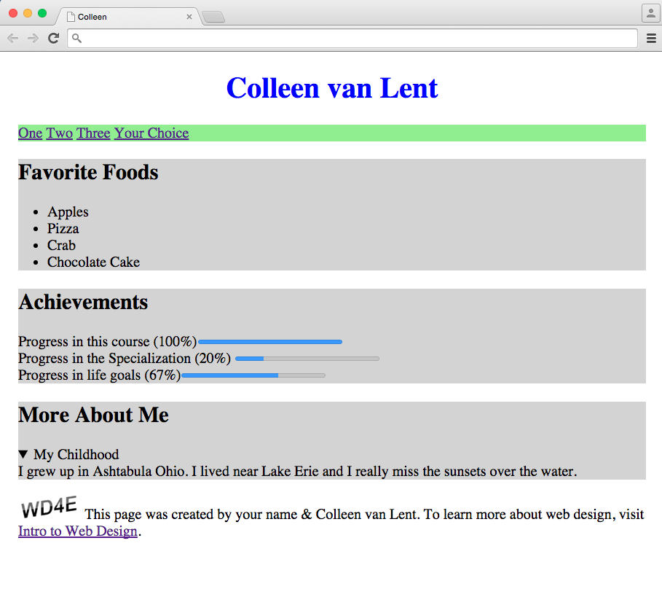

Slide 6
Why not use it?
There are practical reasons for not using style attribute
Only applies to one element
Difficult to change later
Takes away from “reusability”

Slide 7
Cascading Style Sheets
A better way to style your page is to use Cascading Style Sheets
Styling is done in a separate file and the HTML file links to whichever style files work best for that site.

Slide 8

Acknowledgements/Contributions
These slides are Copyright 2015- Colleen van Lent as part of http://www.intro-webdesign.com/ and made available under a Creative Commons Attribution Non-Commercial 4.0 License. Please maintain this last slide in all copies of the document to comply with the attribution requirements of the license. If you make a change, feel free to add your name and organization to the list of contributors on this page as you republish the materials.
Initial Development: Colleen van Lent , University of Michigan School of Information

